Slide 1

Enhancing Prostate Cancer Diagnosis Accuracy with Artificial Intelligence: A Multimodal Approach Using Ensemble Techniques
Submitted By: Mihir Sontake (23241713)
Supervisor: Dr. Meghana Kshirsagar
Submitted to the University of Limerick for the partial fulfilment of degree Master of Science In Software Engineering With Data Analytics (MSc) 2023-24
Department of Computer Science and Information Systems, University of Limerick

Slide 2

Contents
Chapter 1 – INTRODUCTION
Overview
Problem Statement
Research Question
Chapter 2 – LITERATURE REVIEW
Chapter 3 – METHODOLOGY
Chapter 4 – RESULTS AND DISCUSSION
Chapter 5 – CONCLUSIONS AND RECOMMENDATIONS

Slide 3
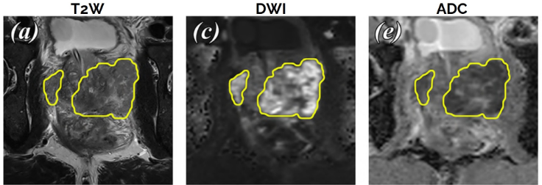
Chapter 1 - INTRODUCTION
Overview
Prostate Cancer (PCa) affects a significant percentage of men.
Identifying Prostate Cancer from MRI scans is challenging.
Fig 1. Example of Malignant csPCa
Notes:
1. In 2022, PCa had an estimated 1.5 million new cases and 397,000 deaths worldwide Bray et al. (2024).
PCa is the world’s second most frequent cancer and the fifth leading cause of cancer death among men Bray et al. (2024).
2. Due to the complexity involved in reading MRI scans, doctors face difficulty in giving an accurate diagnosis He et al. (2023).
High inter-observer and intra-observer variability was observed in MRI interpretation Brembilla G. et al. (2020).

Slide 4
Problem Statement
Chapter 1 - INTRODUCTION
Developing an Artificial Intelligence model that can enhance diagnostic accuracy of clinically significant prostate cancer using an ensemble model trained on a multimodal dataset.
Research Question
Can we enhance the accuracy of Artificial Intelligence models for Prostate Cancer Diagnosis using a multimodal dataset, fine-tuning, and ensemble techniques?

Slide 5
Contents
Chapter 1 – INTRODUCTION
Chapter 2 – LITERATURE REVIEW
State of the Art
Current Gaps in Research
Chapter 3 – METHODOLOGY
Chapter 4 – RESULTS AND DISCUSSION
Chapter 5 – CONCLUSIONS AND RECOMMENDATIONS

Slide 6
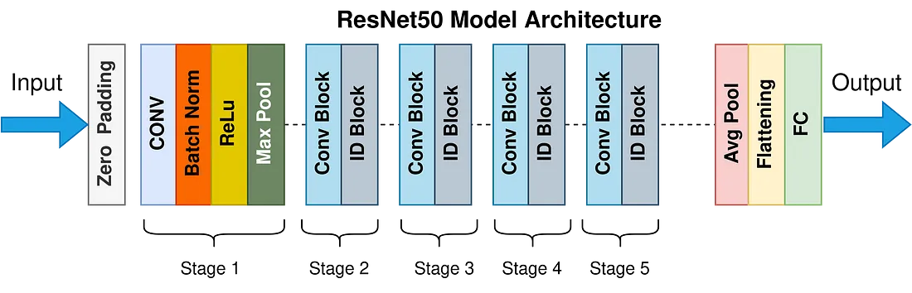
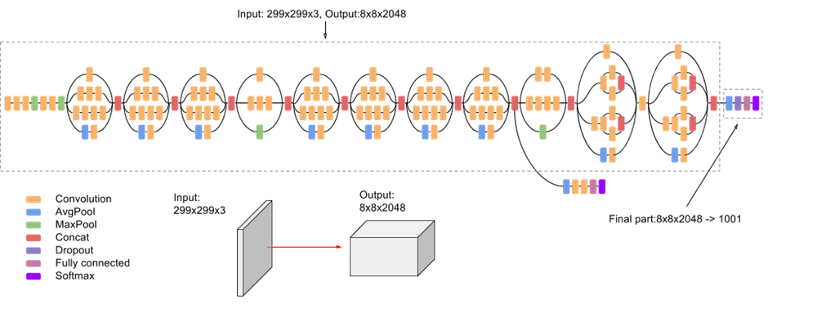
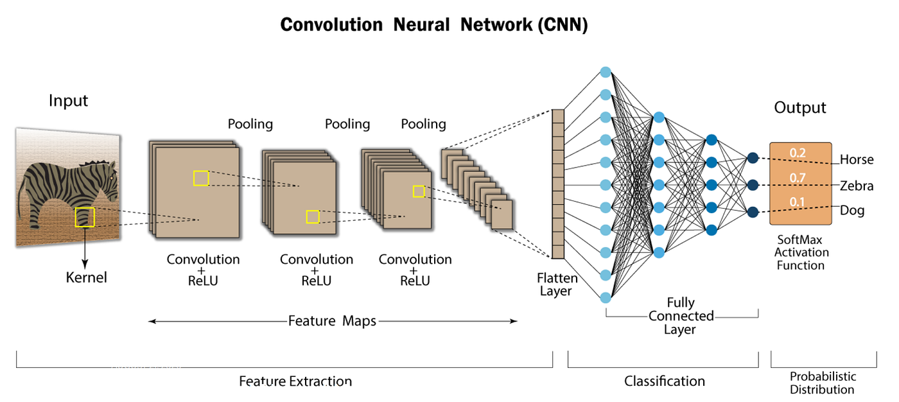
State of the Art
Chapter 2 – LITERATURE REVIEW
The Prostate Cancer Detection Model (PCDM) for prostate cancer automatic diagnosis.
PCDM uses a modified ResNet50-based architecture incorporating dual optimizers and a faster R-CNN.
High rates of sensitivity, specificity, precision, and accuracy were attained by the PCDM, which were 97.40%, 97.09%, 97.56%, and 95.24%, respectively.
Fig 2. ResNet 50 Architecture
Fig 3. Inception v3 Architecture
Fig 4. CNN Architecture

Slide 7
Current Gaps in Research
Chapter 2 – LITERATURE REVIEW
AI algorithms can find distinguishing between benign and malignant tumors difficult.
Enhancing CNN architectures may make DL Algorithms more computationally capable.
Addressing By Fine-tuning our DL models to achieve better performance.
CNNs are known for being a ’black box’ about how decisions are made.
Due to using tiny datasets, AI techniques exhibit difficulty of overfitting.
Addressing By using a large multimodal dataset with annotated data.
The utility of Deep Learning for PCa diagnosis and therapy will be improved by model and algorithm optimization, the addition of multi-omics data, and the growth of medical database resources.
Addressing By using a large multimodal dataset, fine-tuning, transfer learning, and ensemble techniques to enhance the AI model’s diagnostic accuracy.
Notes:
1. Because prostate tissue is complex and imaging data might vary.
3. CNNs may not be as transparent as ML-based techniques, leading some clinicians to avoid utilizing them on real patients outside of research.
4. Because of the use of tiny datasets and the lack of consistency and repeatability in the obtained imaging data.

Slide 8
Contents
Chapter 1 – INTRODUCTION
Chapter 2 – LITERATURE REVIEW
Chapter 3 – METHODOLOGY
Data Collection
Methodology Step 1
Methodology Step 2
MRI Cancer Imaging
Logistic Regression Notebook Results
Support Vector Machine Notebook Results
Convolutional Neural Network Notebook Results
Ensemble Model Building
Chapter 4 – RESULTS AND DISCUSSION
Chapter 5 – CONCLUSIONS AND RECOMMENDATIONS

Slide 9
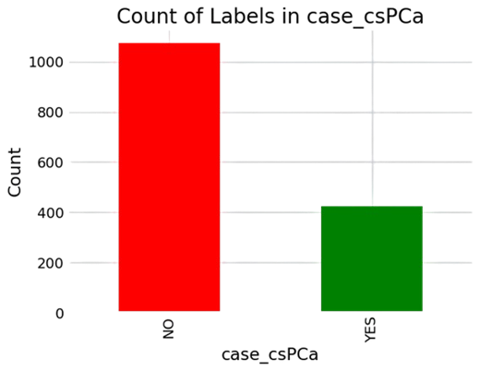
Data Collection
Chapter 3 - METHODOLOGY
The dataset used for this thesis was taken from the PI-CAI (Prostate Imaging: Cancer AI) challenge (https://pi-cai.grand-challenge.org/).
Each patient case includes three standard imaging sequences: axial T2W, axial DWI, and axial ADC scans. In addition to these, patients may also have sagittal and coronal T2W scans, but they are not mandatory.
Fig 5. Class Imbalance for total cases

Slide 10
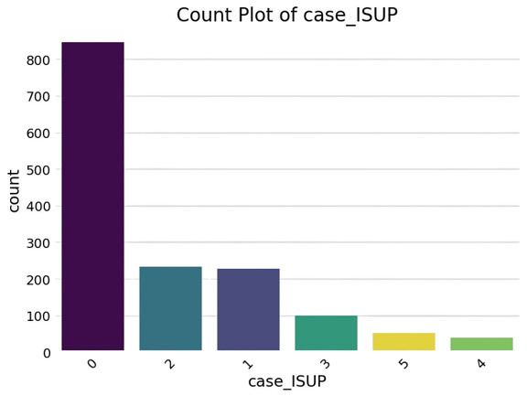
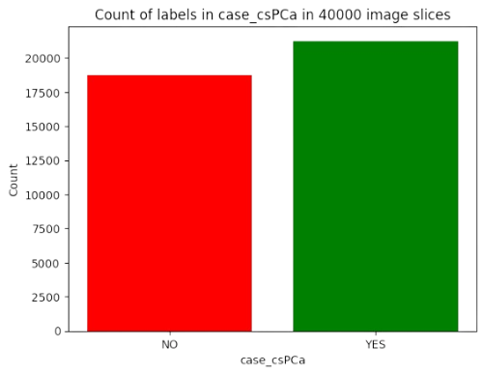
Data Visualisations
Chapter 3 - METHODOLOGY
The Training dataset consists of 34000 images of RGB type of dimensions 256,256.
The Training labels consist of 34000 labels of 1 = YES and 0 = NO.
The Test dataset consists of 6000 images of RGB type of dimensions 256,256.
The Test labels consist of 6000 labels of 1 = YES and 0 = NO.
Fig 6. Data Imbalance for CNN Model
Fig 8. Count of Patients per ISUP Grade

Slide 11
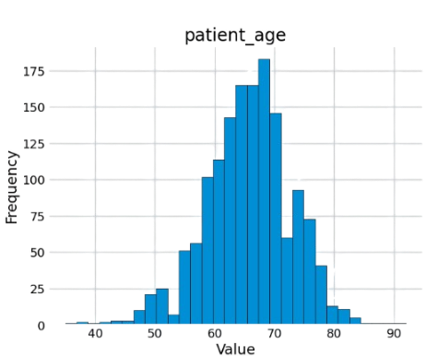
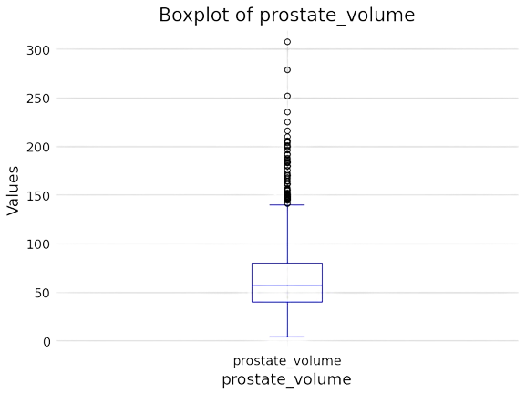
Data Visualisations
Chapter 3 - METHODOLOGY
Fig 10. Histogram of Patient Age
Fig 9. Boxplot of Prostate Volume

Slide 12
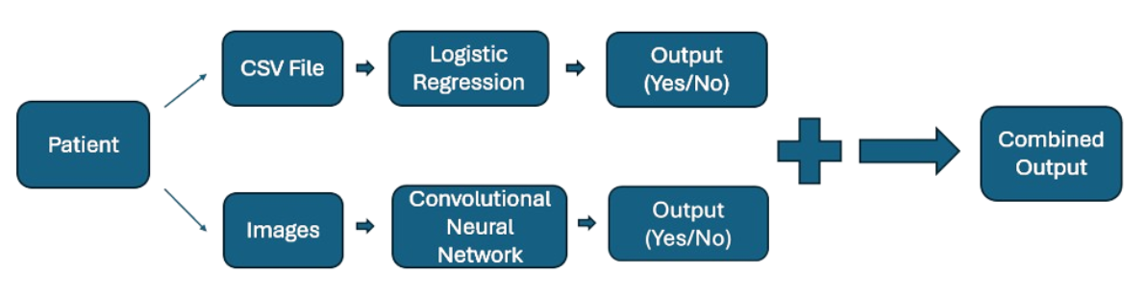
Chapter 3 - METHODOLOGY
Step 1 - Classification of Clinically Significant Prostate Cancer (csPCa)
Logistic Regression:
Input: CSV file.
Steps: Preprocessing and Model training.
Output: Binary classification (Yes/No) for csPCa.
Convolutional Neural Network (CNN):
Input: Medical MRI images in 2d format(JPG).
Steps: Preprocessing and Model training.
Output: Binary classification (Yes/No) for csPCa.
Fig 11. Classification of Clinically Significant Prostate Cancer

Slide 13
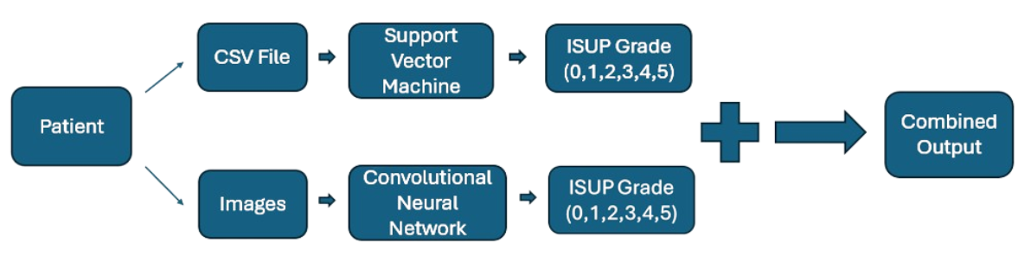
Chapter 3 - METHODOLOGY
Step 2 - Classification of Prostate Cancer ISUP Grade
Support Vector Machines:
Input: CSV file.
Steps: Preprocessing and Model training.
Output: ISUP Grade Prediction classification (ISUP 0,1,2,3,4,5).
Fig 12. Classification of Prostate Cancer ISUP Grade

Slide 14
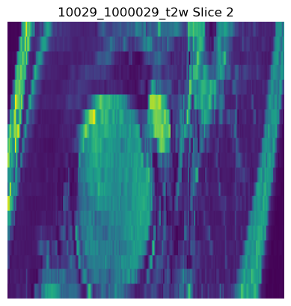
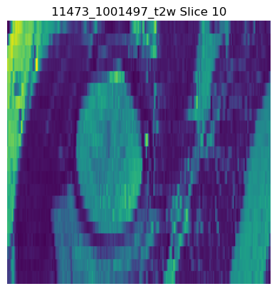
MRI Cancer Imaging
Chapter 3 - METHODOLOGY
Fig 13. PCa Positive Image of T2W MRI type
Fig 14. PCa Negative Image of T2W MRI type

Slide 15
Logistic Regression Notebook
Chapter 3 - METHODOLOGY
Data Preprocessing (CSV File)
Encode the ’csPCa’ labels of ’YES’ and ’NO’ as 1 and 0, respectively.
Drop the columns of ’study id‘, ’patient id’, ’mri date’, ’histopath type’, ’lesion Gleason Score’, ’lesion ISUP’, and ’case ISUP’.
Impute the missing values in column ’psad’.
Drop all rows with missing values.
Apply MinMaxScaler to normalise features.
SMOTE technique generates synthetic data for the minority class.

Slide 16
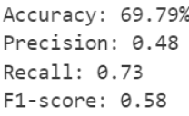
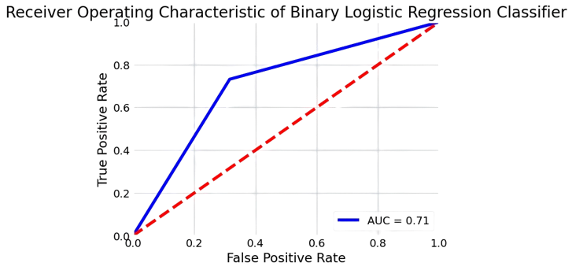

Evaluating Performance of Logistic Regression Classifier
Chapter 3 - METHODOLOGY
Fig 15. Metrics of Logistic Regression
Fig 17. ROC Curve of LR
Fig 16. Confusion Matrix for LR
Accuracy of Predicting Class ‘Yes’ = TP/TP+FN = 68.44%
Accuracy of Predicting Class ‘No’ = TN/TN+FP = 73.17%

Slide 17
Support Vector Machines Notebook
Chapter 3 - METHODOLOGY
Data Preprocessing (CSV File)
Encode the ’csPCa’ labels of ’YES’ and ’NO’ as 1 and 0, respectively.
Drop the columns of ’study id‘, ’patient id’, ’mri date’, and ’case csPca’.
Drop any rows with missing values with `histopath type`, `lesion Gleason Score`, and `lesion_ISUP`.
Impute the missing values in column ’psad’.
One Hot Encode the ‘histopath type’ column.
Convert the `lesion Gleason Score ` column to a new column `max lesion Gleason Score ` to a number by summing the numbers and taking the maximum sum of all lesion sums.
Convert the `lesion ISUP` to a new column `max lesion ISUP` to find the maximum value of a lesion ISUP.
Drop columns - `lesion ISUP` replaced by `max lesion ISUP`, and `lesion Gleason Score` replaced by `max lesion Gleason Score`.
Drop `max lesion ISUP` as it is the same as ‘case ISUP’.
Apply MinMaxScaler to normalise features.
SMOTE technique generates synthetic data for the minority classes.

Slide 18
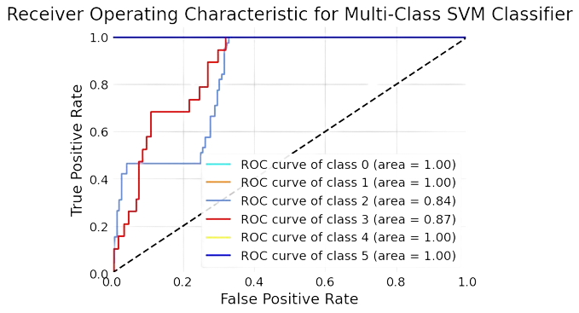
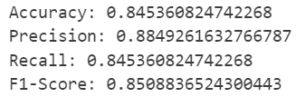
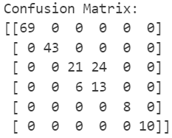
Evaluating Performance of Support Vector Machines Classifier
Chapter 3 - METHODOLOGY
Fig 18. Metrics of SVM
Fig 19. Confusion Matrix of SVM
Fig 20. ROC curve of SVM
Accuracy of Predicting Class ‘0’ = TP/TP+FN = 100%
Accuracy of Predicting Class ‘1’ = TN/TN+FP = 100%
Accuracy of Predicting Class ‘2’ = TP/TP+FN = 46.67%
Accuracy of Predicting Class ‘3’ = TP/TP+FN = 68.42%
Accuracy of Predicting Class ‘4’ = TP/TP+FN = 100%
Accuracy of Predicting Class ‘5’ = TP/TP+FN = 100%

Slide 19
Convolutional Neural Networks Used
Chapter 3 - METHODOLOGY
ID | Model Name | Description
1 | Inception 1 | Inception v3 model with a fully connected output layer having 1 neuron.
2 | Inception 2 | Modified Inception 1 model’s architecture with 6 more layers, dropout and regularization added.
3 | ResNet 1 | ResNet 50 model with a fully connected output layer having 1 neuron.
4 | ResNet 2 | Modified ResNet 1 model’s architecture with 6 more layers, dropout, and regularization added.
Tab 1. CNN Models Used

Slide 20
Convolutional Neural Network Notebook
Chapter 3 - METHODOLOGY
Loading Dataset
We divide the images into ‘Yes’ and ‘No’ folders according to their label.
We extract 2-D images as slices from the MHA images in the dataset.
We use only the top 10 slices from each MHA image.
We store the number of slices in each MHA image in a CSV file (CSV File) (Image).
Data Preprocessing
The data and label arrays are used for the model input.
We use the label 1 for Cancerous Images and 0 for Non-Cancerous Images.
The data array appends all images as number arrays after resizing them to (256, 256) dimensions.
We augment the data to have an equal number of images for each class.

Slide 21
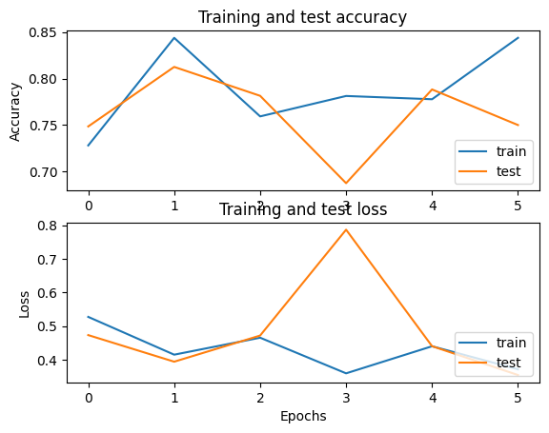
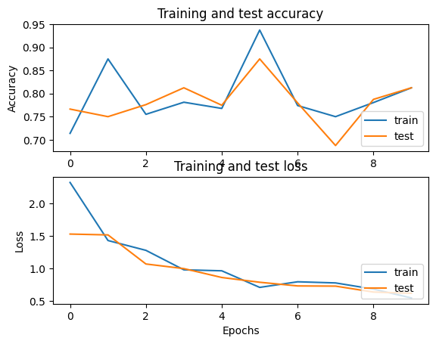
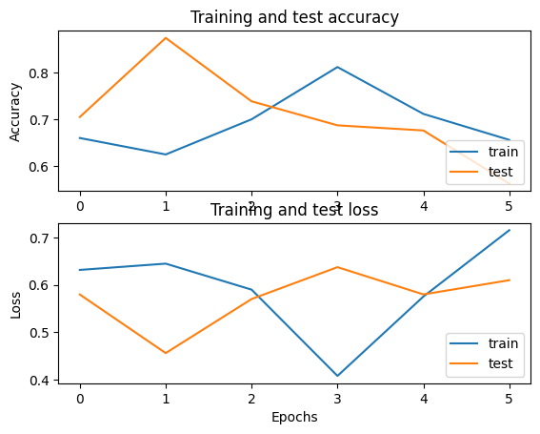
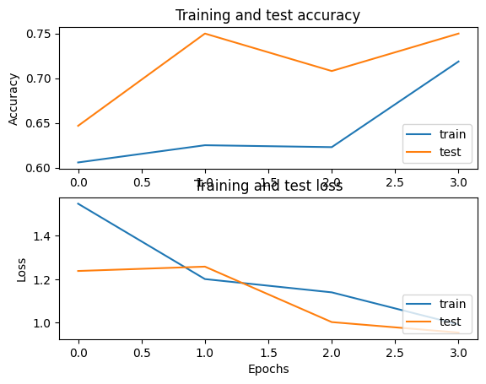
Evaluating the Performance of the 4 ConvNets
Chapter 3 - METHODOLOGY
Fig 23. Inception 1
Fig 24. Inception 2
Fig 25. ResNet 1
Fig 26. ResNet 2

Slide 22
Ensemble Model Building
Chapter 3 - METHODOLOGY
ID | Model | Test Accuracy | Test Loss
1 | Logistic Regression | 0.6979 | -
2 | Inception 1 | 0.75 | 0.35
3 | Inception 2 | 0.73 | 0.72
4 | ResNet 1 | 0.56 | 0.61
5 | ResNet 2 | 0.73 | 1.00
Tab 2. All AI Models Test Accuracies and Test Losses
ID | Logistic Regression Weight (%) | ResNet 2 Weight (%) | Final Accuracy (%)
1 | 50 | 50 | 71.5
2 | 40 | 60 | 71.8
3 | 60 | 40 | 71.2
Tab 3. Ensemble Model Accuracies based on Weight Ratios

Slide 23
Ensemble Model Accuracy
Chapter 3 - METHODOLOGY
We choose the ResNet 2 model as our final CNN model due to its better performance.
It showed a decline in training and test loss with the number of epochs.
It showed an improvement in training and test accuracy with the number of epochs.
The accuracy score of the ResNet 2 model = 73%.
The weights 40:60 give the highest overall accuracy score of 71.8%.
The weight assigned is higher for the ResNet 2 model which has higher accuracy than the Logistic Regression model.

Slide 24
Contents
Chapter 1 – INTRODUCTION
Chapter 2 – LITERATURE REVIEW
Chapter 3 – METHODOLOGY
Chapter 4 – RESULTS AND DISCUSSION
Presentation of Results
Chapter 5 – CONCLUSIONS AND RECOMMENDATIONS

Slide 25
Chapter 4 – RESULTS AND DISCUSSION
Presentation of Results
The logistic regression algorithm to predict whether the patient has clinically significant prostate cancer has an accuracy of 69.79%.
The support vector machine classifier to predict the ISUP grade of Prostate cancer has an accuracy of 84.53%.
The ResNet 2 model to predict whether a patient has clinically significant prostate cancer has an accuracy of 73%.
The Weight Ratio Selection section of 40:60 is the ideal weight ratio for our ensemble AI model with the highest accuracy of 71.8%.

Slide 26
Contents
Chapter 1 – INTRODUCTION
Chapter 2 – LITERATURE REVIEW
Chapter 3 – METHODOLOGY
Chapter 4 – RESULTS AND DISCUSSION
Chapter 5 – CONCLUSIONS AND RECOMMENDATIONS
Conclusion
Future Work

Slide 27
Chapter 5 – CONCLUSION AND RECOMMENDATION
Conclusion
The AI model can help doctors and clinicians diagnose prostate cancer reliably and quickly.
It can act as a second opinion for experienced doctors which can confirm their readings.
There can be further improvements in hyperparameters, better deep learning models, and other transfer learning models.
In future, new deep learning models for predicting the ISUP grade of Prostate Cancer can be developed and experimented with to enhance their accuracy.
We also can explore using different MRI sequences in combination to achieve better accuracy as required by the project.
Future Work

Slide 28
References
Alshuhri, M., Al-Musawi, S. G., Al-Alwany, A. A., Uinarni, H., Rasulova, I., Rodrigues, P., Alkhafaji, A. T., Alshanberi, A. M., Alawadi, A. H. and Abbas, A. H. (2023), ‘Artificial intelligence in cancer diagnosis: Opportunities and challenges’, Pathology-Research and Practice p. 154996.
AmericanCancerSociety (n.d.), ‘Tests to diagnose and stage prostate cancer’, https://www.cancer.org/cancer/types/prostate-cancer/detection-diagnosis-staging/how-diagnosed.html. Accessed: 02.07.2024.
Bray, F., Laversanne, M., Sung, H., Ferlay, J., Siegel, R. L., Soerjomataram, I. and Jemal, A. (2024), ‘Global cancer statistics 2022: Globocan estimates of incidence and mortality worldwide for 36 cancers in 185 countries’, CA: a cancer journal for clinicians 74(3), 229–263.
Brembilla, G., Dell’Oglio, P., Stabile, A., Damascelli, A., Brunetti, L., Ravelli, S., Cristel, G., Schiani, E., Venturini, E., Grippaldi, D. et al. (2020), ‘Interreader variability in prostate mri reporting using prostate imaging reporting and data system version 2.1’, European radiology 30, 3383–3392.
CancerResearchUK (n.d.), ‘Tests for prostate cancer’, https://www.cancerresearchuk.org/about-cancer/prostate-cancer/getting-diagnosed/tests-for-prostate-cancer. Accessed: 02.07.2024.
Corradini, D., Brizi, L., Gaudiano, C., Bianchi, L., Marcelli, E., Golfieri, R., Schiavina, R., Testa, C. and Remondini, D. (2021), ‘Challenges in the use of artificial intelligence for prostate cancer diagnosis from multiparametric imaging data’, Cancers 13(16), 3944.

Slide 29
References
Datacamp (n.d.), ‘What is machine learning? definition, types, tools more’, https://www.datacamp.com/blog/what-is-machine-learning. Accessed: 10.07.2024.
De Vente, C., Vos, P., Hosseinzadeh, M., Pluim, J. and Veta, M. (2020), ‘Deep learning regression for prostate cancer detection and grading in bi-parametric mri’, IEEE Transactions on Biomedical Engineering 68(2), 374–383.
Deng, J., Dong, W., Socher, R., Li, L.-J., Li, K. and Fei-Fei, L. (2009), ImageNet: A Large-Scale Hierarchical Image Database, in ‘CVPR09’.
Gould, M. (2010), ‘Giscience grand challenges: How can research and technology in this field address big-picture problems? arcuser, 13 (4), 64–65’.
He, K., Zhang, X., Ren, S. and Sun, J. (2016), Deep residual learning for image recognition, in ‘Proceedings of the IEEE conference on computer vision and pattern recognition’, pp. 770–778.
He, M., Cao, Y., Chi, C., Yang, X., Ramin, R., Wang, S., Yang, G., Mukhtorov, O., Zhang, L., Kazantsev, A. et al. (2023), ‘Research progress on deep learning in magnetic resonance imaging–based diagnosis and treatment of prostate cancer: a review on the current status and perspectives’, Frontiers in Oncology 13, 1189370.
IBM (n.d.a), ‘What are support vector machines (svms)?’, https://www.ibm.com/
topics/support-vector-machine. Accessed: 15.07.2024.
IBM (n.d.b), ‘What is deep learning?’, https://www.ibm.com/topics/deep-learning. Accessed: 16.07.2024.
IBM (n.d.c), ‘What is logistic regression?’, https://www.ibm.com/topics/logistic-regression. Accessed: 13.07.2024.
IBM (n.d.d), ‘What is machine learning (ml)?’, https://www.ibm.com/topics/machine-learning. Accessed: 10.07.2024.
Ishioka, J., Matsuoka, Y., Uehara, S., Yasuda, Y., Kijima, T., Yoshida, S., Yokoyama, M., Saito, K., Kihara, K., Numao, N. et al. (2018), ‘Computer-aided diagnosis of prostate cancer on magnetic resonance imaging using a convolutional neural network algorithm’, BJU international 122(3), 411–417.

Slide 30
References
Leake, J. L., Hardman, R., Ojili, V., Thompson, I., Shanbhogue, A., Hernandez, J. and Barentsz, J. (2014), ‘Prostate mri: access to and current practice of prostate mri in the united states’, Journal of the American College of Radiology 11(2), 156–160.
MayoClinic (n.d.), ‘Prostate gland’, https://www.mayoclinic.org/diseases-conditions/prostate-cancer/multimedia/prostate-gland/img-20006060. Accessed: 01.07.2024.
Michaely, H. J., Aringhieri, G., Cioni, D. and Neri, E. (2022), ‘Current value of biparametric prostate mri with machine-learning or deep-learning in the detection, grading, and characterization of prostate cancer: a systematic review’, Diagnostics 12(4), 799.
NIBIB (n.d.), ‘Magnetic resonance imaging (mri)’, https://www.nibib.nih.gov/science-education/science-topics/magnetic-resonance-imaging-mri. Accessed: 15.06.2024.
Opengenus (n.d.), ‘Inception v3 model architecture’, https://iq.opengenus.org/inception-v3-model-architecture/. Accessed: 20.07.2024.
Pecoraro, M., Messina, E., Bicchetti, M., Carnicelli, G., Del Monte, M., Iorio, B., La Torre, G., Catalano, C. and Panebianco, V. (2021), ‘The future direction of imaging in prostate cancer: Mri with or without contrast injection’, Andrology 9(5), 1429–1443.
Pellicer-Valero, O. J., Marenco Jimenez, J. L., Gonzalez-Perez, V., Casanova Ramon-Borja, J. L., Mart´ın Garc´ıa, I., Barrios Benito, M., Pelechano Gomez, P., Rubio-Briones, J., Rup´erez, M. J. and Mart´ın-Guerrero, J. D. (2022), ‘Deep learning for fully automatic detection, segmentation, and gleason grade estimation of prostate cancer in multiparametric magnetic resonance images’, Scientific reports 12(1), 2975.
PI-CAI (n.d.), ‘The pi-cai challenge’, https://pi-cai.grand-challenge.org/. Accessed: 15.06.2024.
ProstateX (n.d.), ‘Prostatex’, https://prostatex.grand-challenge.org/. Accessed:15.06.2024.
RadiologyAssistant (n.d.), ‘Prostate cancer - pi-rads v2.1’, https://radiologyassistant.nl/abdomen/prostate/prostate-cancer-pi-rads-v2-1.Accessed: 03.07.2024. xiii,.

Slide 31
References
Radiopaedia (n.d.a), ‘Apparent diffusion coefficient’, https://radiopaedia.org/articles/apparent-diffusion-coefficient-1. Accessed: 04.07.2024.
Radiopaedia (n.d.b), ‘Diffusion-weighted imaging’, https://radiopaedia.org/articles/diffusion-weighted-imaging-2. Accessed: 04.07.2024.
Radiopaedia (n.d.c), ‘T2 weighted image’, https://radiopaedia.org/articles/t2-weighted-image. Accessed: 04.07.2024.
Roboflow (n.d.), ‘What is resnet-50?’, https://blog.roboflow.com/what-is-resnet-50/. Accessed: 21.07.2024.
Russakovsky, O., Deng, J., Su, H., Krause, J., Satheesh, S., Ma, S., Huang, Z., Karpathy, A., Khosla, A., Bernstein, M., Berg, A. C. and Fei-Fei, L. (2015), ‘ImageNet Large Scale Visual Recognition Challenge’, International Journal of Computer Vision (IJCV) 115(3), 211–252.
Saha, A., Bosma, J. S., Twilt, J. J., van Ginneken, B., Bjartell, A., Padhani, A. R., Bonekamp, D., Villeirs, G., Salomon, G., Giannarini, G. et al. (2024), ‘Artificial intelligence and radiologists in prostate cancer detection on mri (pi-cai): an international, paired, non-inferiority, confirmatory study’, The Lancet Oncology.
Sciencedirect (n.d.), ‘Inception v3’, https://www.sciencedirect.com/topics/computer-science/inception-v3. Accessed: 20.07.2024.
Simplilearn (n.d.a), ‘Convolutional neural network tutorial’, https://www.simplilearn.com/tutorials/deep-learning-tutorial/convolutional-neural-network. Accessed: 17.07.2024.
Simplilearn (n.d.b), ‘Top 10 deep learning algorithms you should know in 2024’, https://www.simplilearn.com/tutorials/deep-learning-tutorial/deep-learning-algorithm#how_deep_learning_algorithms_work. Accessed: 16.07.2024.
spiceworks (n.d.), ‘What is logistic regression? equation, assumptions, types, and best practices’, https://www.spiceworks.com/tech/artificial-intelligence/articles/what-is-logistic-regression/. Accessed: 13.07.2024.

Slide 32
References
Srigley, J. R., Delahunt, B., Egevad, L., Samaratunga, H., Yaxley, J. and Evans, A. J. (2016), ‘One is the new six: The international society of urological pathology (isup) patient-focused approach to gleason grading’, Canadian Urological Association Journal 10(9-10), 339.
Szegedy, C., Vanhoucke, V., Ioffe, S., Shlens, J. and Wojna, Z. (2016), Rethinking the inception architecture for computer vision, in ‘Proceedings of the IEEE conference on computer vision and pattern recognition’, pp. 2818–2826.
Talaat, F. M., El-Sappagh, S., Alnowaiser, K. and Hassan, E. (2024), ‘Improved prostate cancer diagnosis using a modified resnet50-based deep learning architecture’, BMC Medical Informatics and Decision Making 24(1), 23.
Turkbey, B., Rosenkrantz, A. B., Haider, M. A., Padhani, A. R., Villeirs, G., Macura, K. J., Tempany, C. M., Choyke, P. L., Cornud, F., Margolis, D. J. et al. (2019), ‘Prostate imaging reporting and data system version 2.1: 2019 update of prostate imaging reporting and data system version 2’, European urology 76(3), 340–351.
Wang, Z., Liu, C., Cheng, D., Wang, L., Yang, X. and Cheng, K.-T. (2018), ‘Automated detection of clinically significant prostate cancer in mp-mri images based on an endto-end deep neural network’, IEEE transactions on medical imaging 37(5), 1127–1139.

Slide 33
Thank You! Q & A

Slide 34
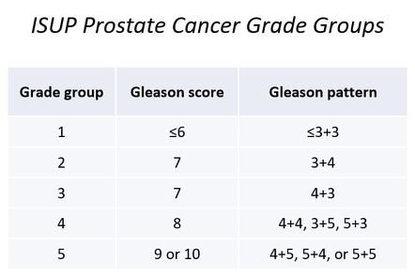
Appendix
Table: ISUP Grades and Lesion Gleason Score and Gleason Patterns (Source: https://radiopaedia.org/cases/isup-prostate-cancer-grade-groups-table-1#image-45080910)

Slide 35
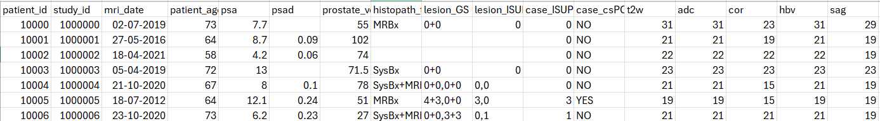
Appendix
Fig. Dataframe with number of slices

